Slide 1

Cash Handling Basics
Office of the Bursar
Cash Operations
2017

Slide 2
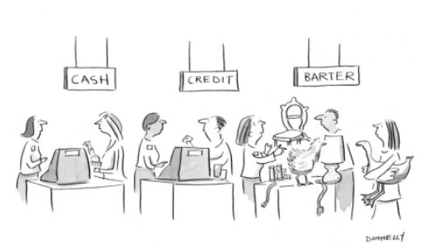
Methods of Receipt
Payments may be received by your department in a variety of ways and in various forms.
- In person
    Cash and coin
    Checks and money orders
    Credit cards by merchant account holders only
  Mail
    Checks and money orders
    Never cash

Slide 3

What Will We Learn?
It’s important that all staff involved in the payment process be properly trained in cash handling.
Best Practices in Cash Collections
Basics of Cash Depositing at UConn
Checking Checks
Identifying and Handling Counterfeit Bills
Change Funds
Over/Under Guidelines
Notes:
Main policy points pertaining to cash handling

Slide 4

Best Practices in Cash Collections
Proper recording and documentation of transactions
Security
Separation of duties and responsibilities
Timeliness of deposit
Reconciliation
Notes:
Responsibility as management to reduce exposure for improper cash handling procedures.

Slide 5

Best Practices: Proper Recording & Documentation of Transactions
First step in the cash collection process
Provides a financial record of each event to ensure accuracy and completeness of transactions
  Evidence of what transpired
    Who, Where, Why, When, and How
  Provides information needed for researching discrepancies
  Failure to complete this step results in the inability to balance or reconcile
Supporting documentation for all deposits must be attached to your KFS eDoc

Slide 6
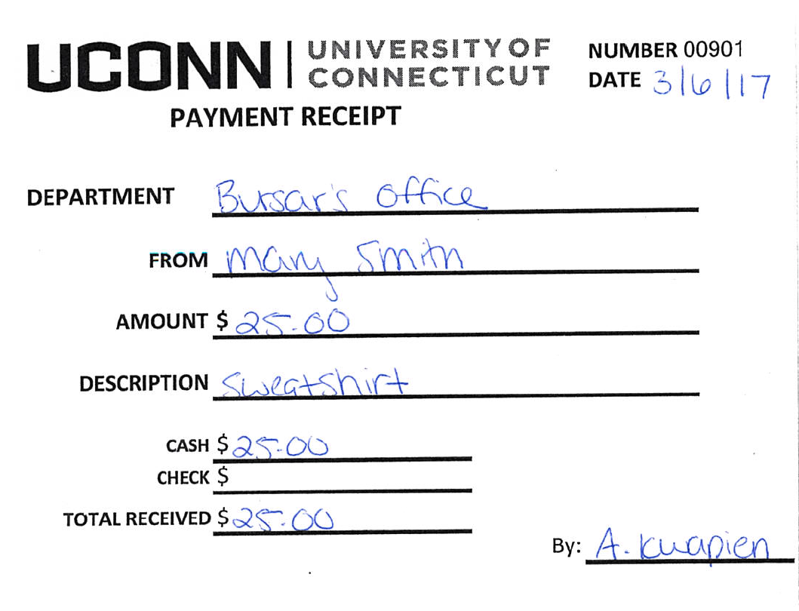
How do I Properly Document
In-Person Payments?
Input the payment into an electronic device, such as a cash register or computer terminal to ensure all payments are documented
Departments without an electronic device should track payments manually with pre-numbered receipts.
  Receipts can be provided by Cash Operations upon request!

Slide 7
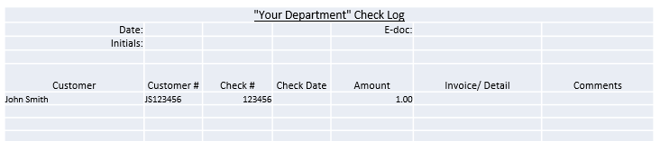
How do I Properly Document
Checks Received in the Mail?
Record all checks on a check log
  Documents the Who, Where, When, Why, and How
  Use in daily balancing and reconciliations to support timely and complete processing of all payments

Slide 8
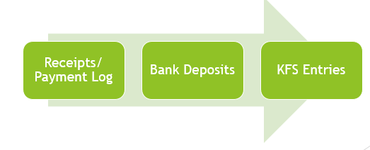
Why Log Your Payments?
The log provides a clear picture of all payments received on a given day
Provides supporting documentation to balance your cash/checks against
Gives reconcilers the information they need to verify funds are credited in KFS, and credited accurately
Payment logs can be used for payments received in the mail as well as in-person. Note: Receipts must still be used for in-person payments even if logged.

Slide 9

Security
Access to areas handling cash, checks, or credit cards, should be limited to designated employees.
During business hours, all forms of cash should be stored in locking drawers, cash registers, and cash boxes.
Limit number of staff with access to the drawer/safe to an operational minimum.
Change combinations at least annually, or when someone who had access leaves the department.

Slide 10
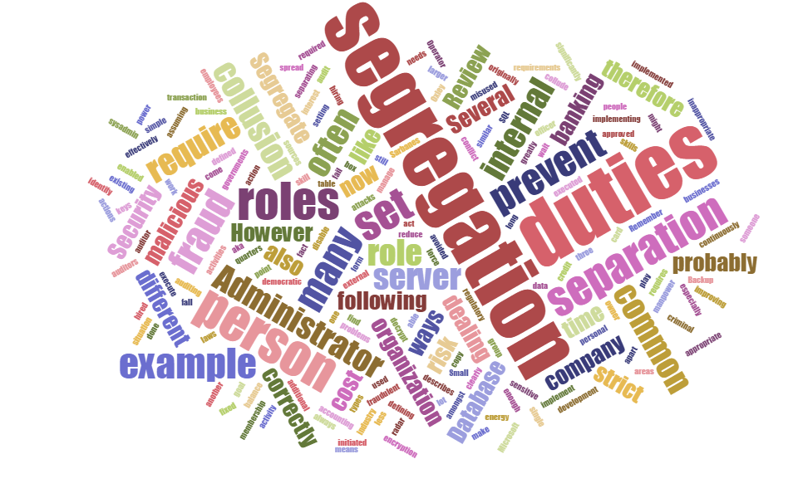
Separation of Duties and
Responsibilities
Prevents fraud and error
Fundamental building block of risk management and internal controls
One person should not be accepting, processing, depositing, and reconciling the deposit. Multiple people should be involved in the process from start to finish.
We understand that some departments are limited in the number of staff members available for these functions, but wherever possible this should be the ultimate goal.

Slide 11

Timeliness of Deposits
When possible, deposit of funds received should
be made every business day.
Deposits totaling $500 or more must be deposited by the end of the following business day. This is mandated by State Statute 4-32.
Deposits under $500 must be deposited within 7 calendar days of being received.
  **Please note** KFS edocs should still be submitted daily for departments who opt to hold smaller amounts for the 7 day period

Slide 12
Here’s an Example..
Mary’s cash/check totals for the week are as follows:
  Monday - $20.00 cash 40.00 check
  Tuesday – no payments
  Wednesday – no payments
  Thursday – no cash $20.00 check
  Friday – $25.00 cash $20.00 check
KFS eDocs for the week would be :
  Monday – eDoc for $60.00
  Tuesday & Wednesday – no eDocs
  Thursday – eDoc for $20.00
  Friday – eDoc for $45.00 and deposit to the bank/CashOps of $45.00 cash, $80.00 check
Total eDocs submitted for the week will equal the one bank/CashOps deposit.
If $500 threshold is reached, more than one deposit will be required.

Slide 13

Reconciliation
Necessary to confirm that deposits are recorded correctly
Performed by an individual outside of the deposit process
At least monthly, someone not involved in the deposit collection process should review all backup documentation for deposits to ensure that all funds have been processed into the appropriate KFS account fully and correctly
Discrepancies should be researched immediately. Contact Cash Operations if any issues arise.

Slide 14

Reconciliation Process
There is not one set process of reconciling, but these are best practices:
Record cash receipts when received
Count and balance cash receipts to backup documentation daily
Compare documentation of receipts to deposits in KFS
Perform periodic surprise cash counts of change funds and cash drawers

Slide 15

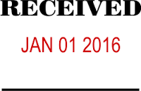
Basics of Cash Depositing at UConn
Mandated Cash Control Training must be completed annually by all relevant employees, staff or student
It is the department’s responsibility to ensure all appropriate staff are enrolled in and complete the annual training
Cash/Checks should never be sent via campus mail. The only way to guarantee delivery of your deposit is to hand deliver it and obtain a receipt.
The received date should be indicated (hand-written or by stamp) on each check you receive in your office.
  We recommend that the received date
  of the deposit also be included as a
  note in your eDoc.
CR or AD eDoc must be submitted in KFS every day that funds are received

Slide 16
Documentation Retention
All fiscal documentation is subject to the Municipal Records Retention Schedule M3 which states that certain documentation must be kept for a certain number of years (specified in the schedule) or until audited.
Documentation subject to retention policies includes, but is not limited to:
  Paper bills or invoices
  Daily payment logs
  Customer receipts
  Deposit receipts from Bank of America
When documentation is ready to be destroyed, form RC-108 must be filled out and submitted to Betsy Pittman, the University Archivist, for proper approval
It is your responsibility to store and safeguard your financial documents for the required number of years, and to obtain the proper permission to destroy it.
For additional information regarding record retention when using KFS, please visit: http://accountspayable.uconn.edu/important-information-regarding-record-retention-when-using-kfs/

Slide 17
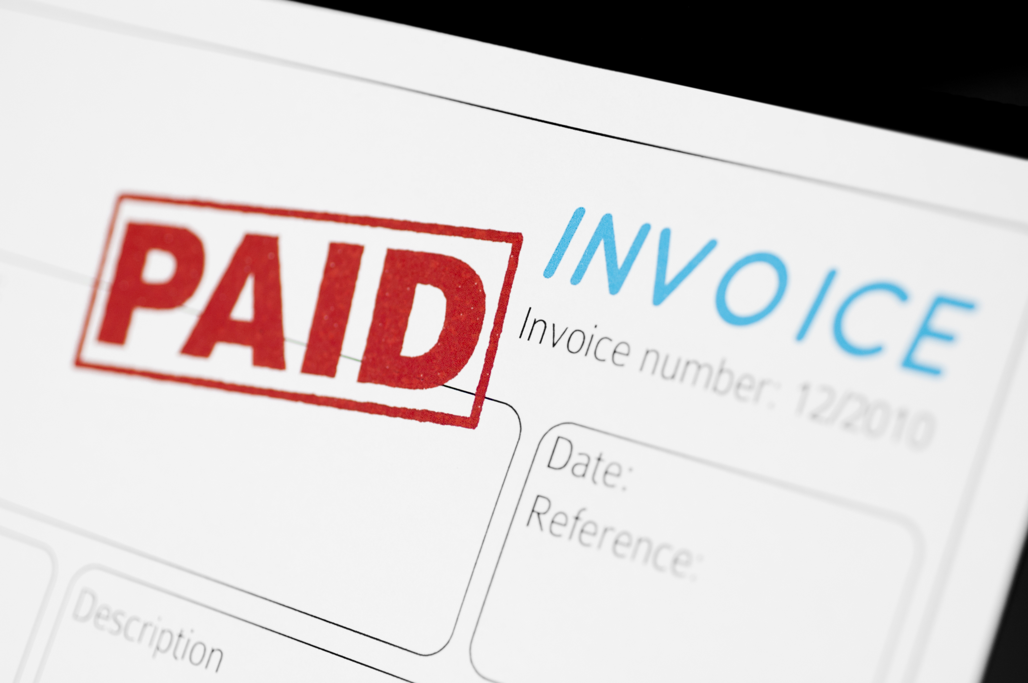
Invoicing
Invoicing in KFS is preferred and recommended when billing vendors.
  This eliminates payments being sent directly to departments
  For detailed descriptions on creating customers and invoicing in KFS please see Procedure Guide for A/R invoicing

Slide 18
What Type of eDoc Should I Submit?
Cash Receipts (CR) eDocs are used when cash and/or checks are brought to Cash Operations for deposit.
  Cash and check received the same day can be recorded together on one CR.
Advance Deposit (AD) eDocs are used when funds are credited directly to Bank of America and do not come through Cash Operations.
  This includes: RDS check deposits, Regional campuses and other off-campus locations, Dunbar Cash Vault deposits, Wire/ACH payments
  Cash and check received the same day can be recorded together on one AD but each currency amount must be listed separately on the Advance Deposit tab
Note: Documentation agreeing to the deposit total must be attached to each eDoc, regardless if you use CR or AD

Slide 19
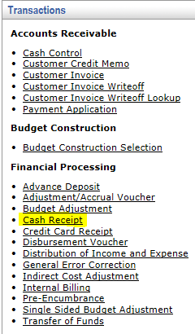

Initiating the eDoc - CR
To create a Cash Receipt:
Main Menu Tab
Transactions
Financial Processing
Cash Receipt

Slide 20
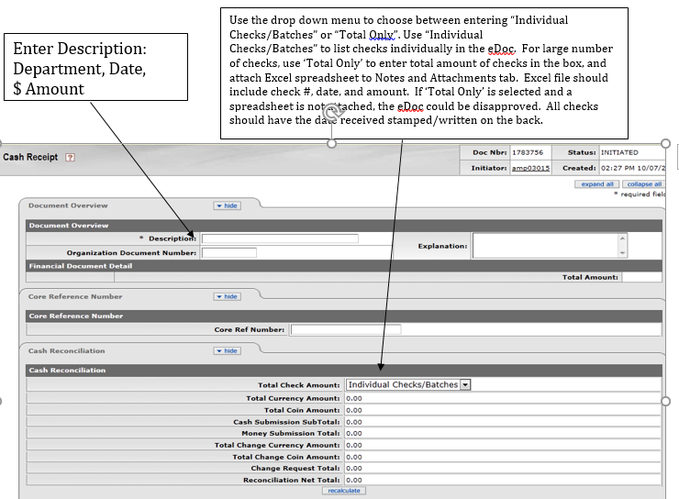
Cash Receipt

Slide 21
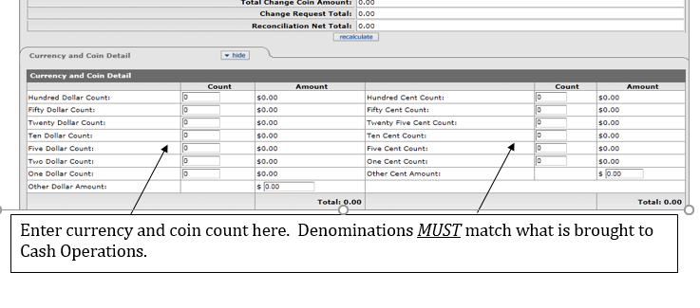
Cash Receipt Currency

Slide 22
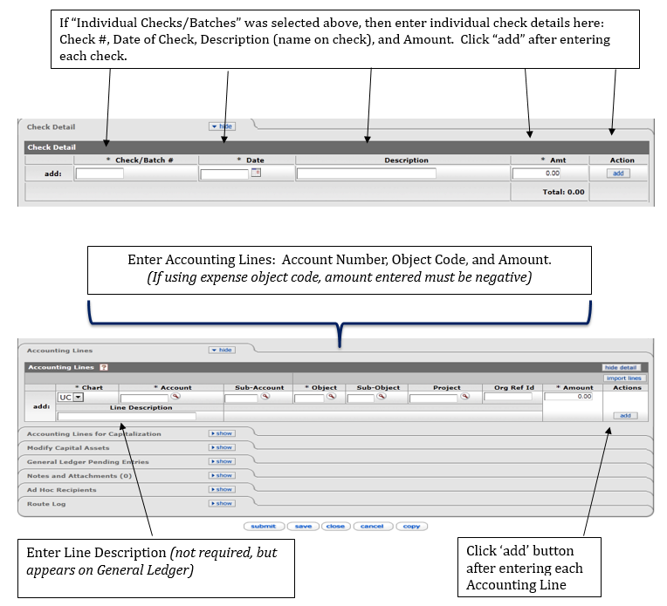
Cash Receipt Currency (2)

Slide 23
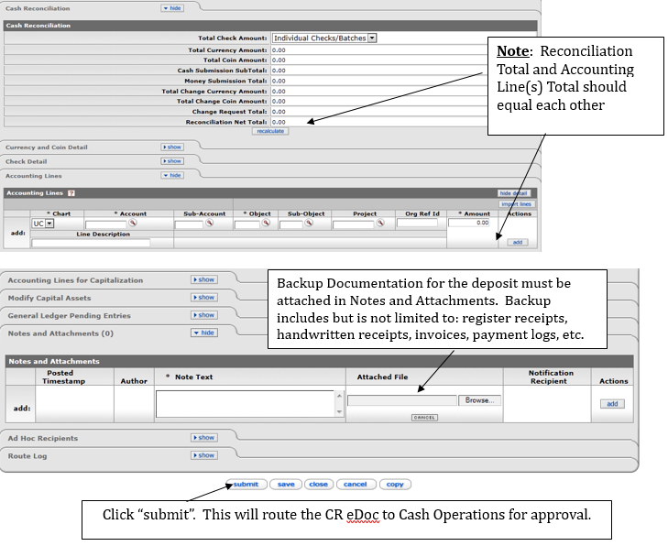
Cash Receipt Reconciliation

Slide 24
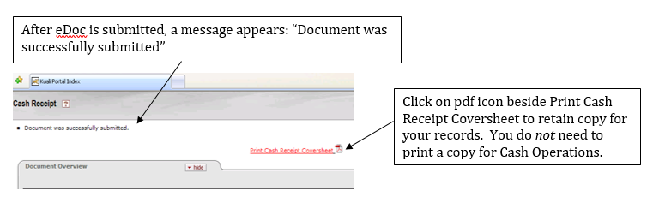
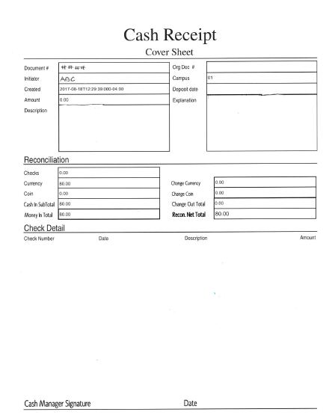

Cash Receipt eDoc submitted

Slide 25
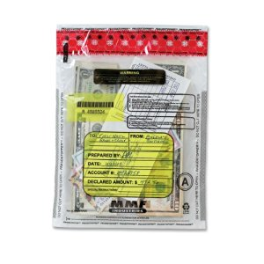
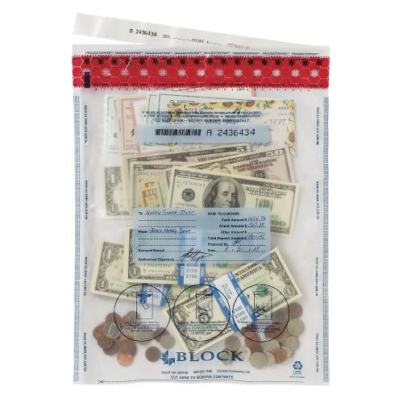
Delivering the Deposit
All deposits brought to Cash Operations must be delivered in a sealed fraud-stopper bag. These bags can be obtained from Cash Operations or you may use your own as long as they are tamper-proof.

Slide 26
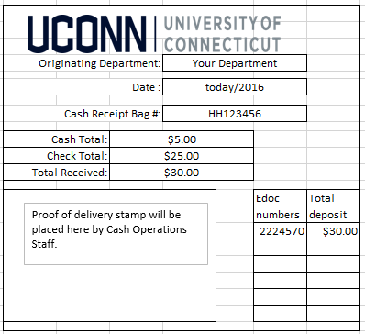
Delivering the Deposit (2)
Two copies of the Cash Receipt Form, which can be found on the Bursar website, should be filled out and left outside the bag.
This receipt is your proof of delivery to Cash Operations and should be retained by your department as backup documentation for that day’s deposit.

Slide 27
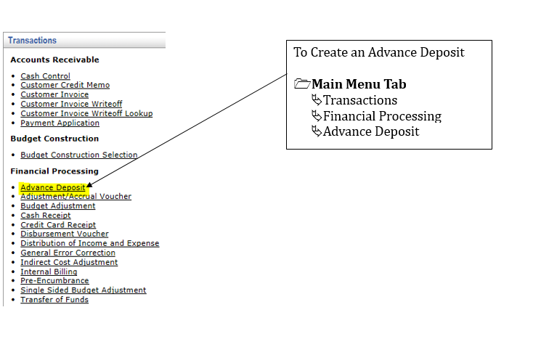
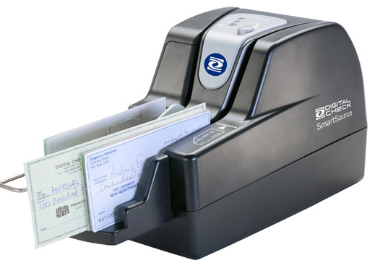
Initiating the eDoc - AD

Slide 28
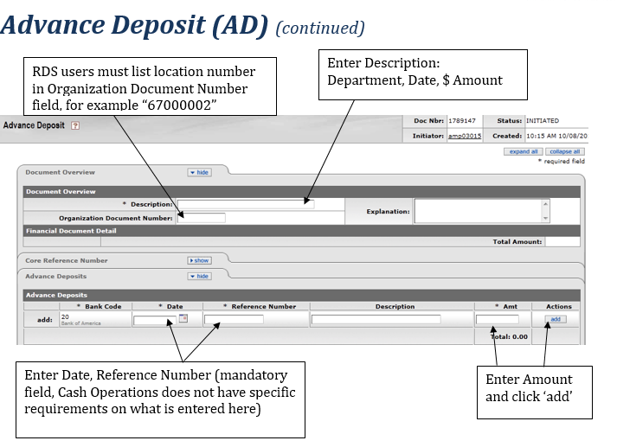
Advance Deposit (continued)

Slide 29
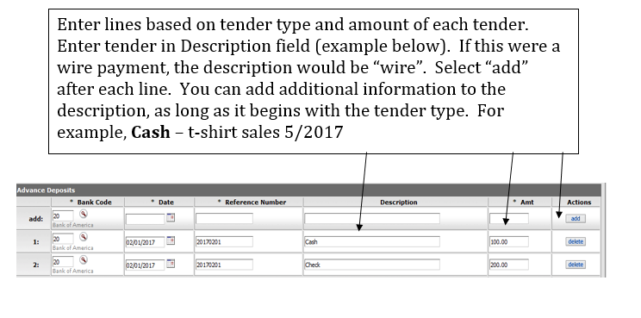
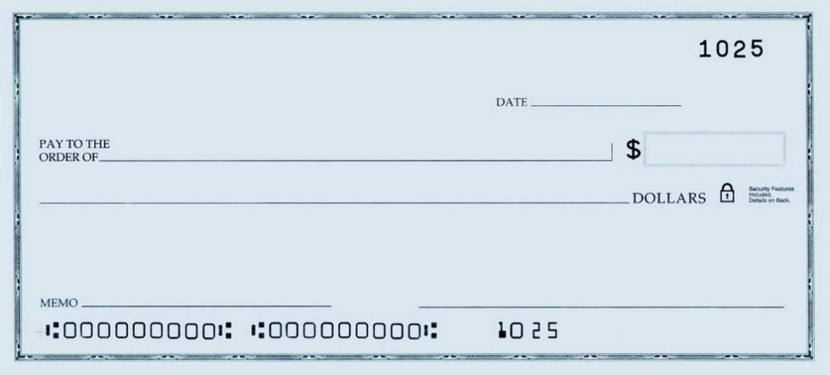

Advance Deposit Tender

Slide 30
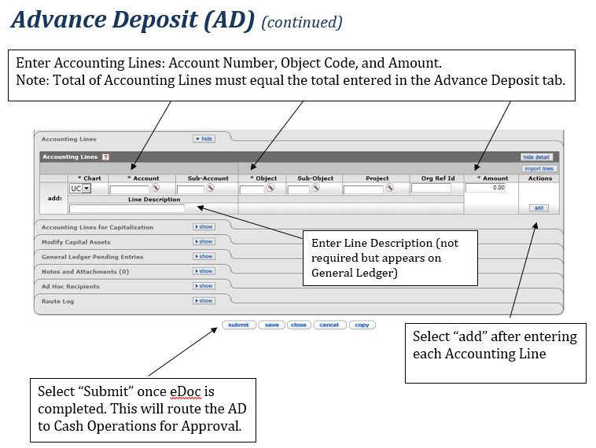
Advance Deposit Accounting

Slide 31

Check Payments
Made Payable to the University department– “UConn” or “University of Connecticut” should be included on the Pay to the Order of Line
Ensure that the legal line on the check matches the numerical line before the customer leaves so they can fix any discrepancies
Any changes should be made by the customer who is writing the check and never by the department or the person accepting the check payment.
  If the customer makes any changes, they should be instructed to write their initials next to the change made.
Stamp or write the received date of the payment on the back of the check immediately upon receipt.
If check is received in the mail, log the check information (customer name, check date, check amount, and check number) in an excel spreadsheet or, if applicable, input the check information in a system outside of KFS.
Remember: Receipts must be given and a copy retained for check payments received in-person (not only for cash!)

Slide 32
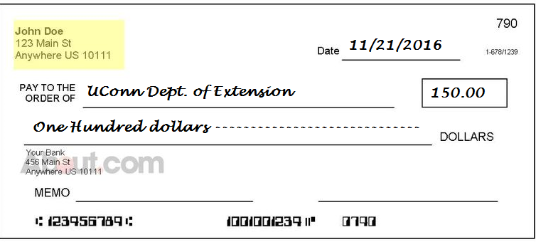
Check the Check!
Missing
signature
The legal amount of the check is the written words. In this case, the check is only
worth 100.00, regardless of the numeric amount.
What else is wrong with this check?

Slide 33
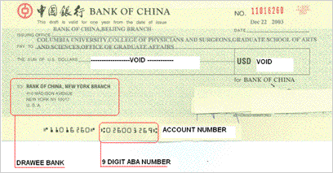
Foreign Checks
Checks must be drawn on a U.S. Bank. Checks drawn on a foreign bank (including Canada) will be returned to the department.
  To determine if a check is foreign, use the following three questions:
    Is the check written in a currency other than $US
    Is the location of the drawee bank on the check outside the U.S.? Although a bank is in a foreign country, it may state a drawee bank in the U.S. from which the funds will be drawn.
    Is there a nine digit ABA number printed on the bottom line of the check?

Slide 34
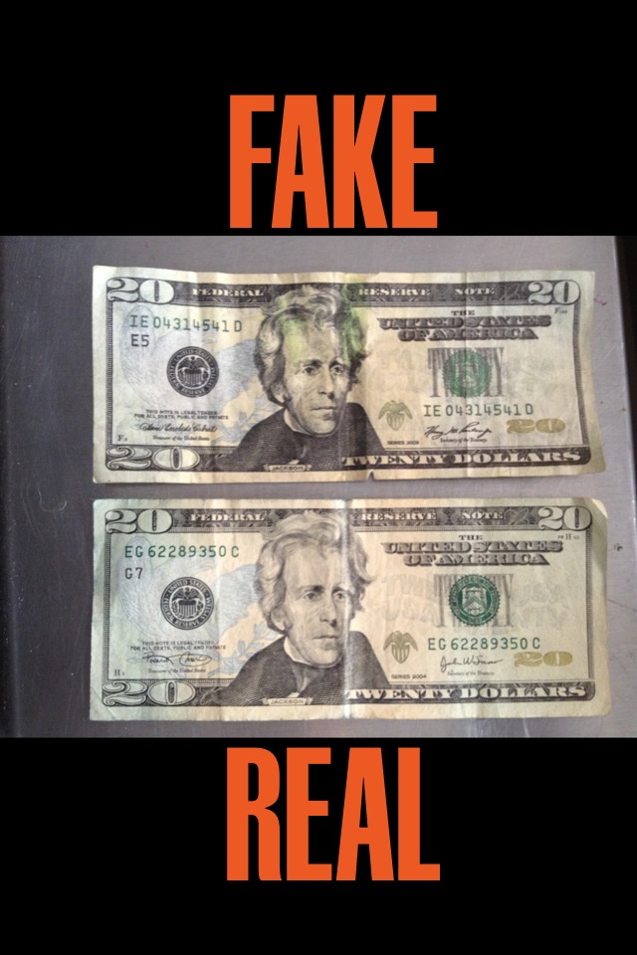

Counterfeit Bills
Do you know how to determine the legitimacy of a bill?

Slide 35
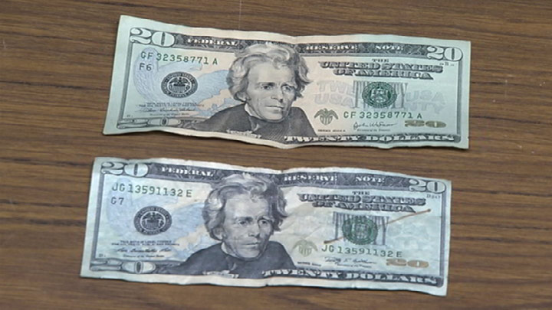
Counterfeit Bills: Identifying the Fake
Look/Feel – Fake bills will have a different feel from authentic bills. Be aware of any difference in texture or appearance. This can be the first indication that a bill might be fraudulent.
Mark bill with a counterfeit detecting marker. Markers will be invisible/yellow on authentic bills but show as black/brown on a fake. However, markers are not always accurate and can give false results. Take other security features into account when you suspect a fake.
Possible Fake

Slide 36
Identifying the Fake: Security Features
  Hold bill up to the light and look for the holograph of the face image on the bill. The images should match. This is a watermark in the paper that can be seen from both sides of the bill.
  There is a thin vertical strip containing text that spells out the bill’s denomination, for example, USA TWENTY.
  Color shifting ink – the numeral in the lower right hand corner has color shifting ink.
  Microprinting – location and text of microprinting is specific to denomination. To learn more about this feature visit U.S. Currency Education Program

Slide 37
Counterfeit Bill: Now What?
Call UCPD as soon as possible after receipt and identification of suspect bill
  Keep handling of the bill to a minimum. If possible, safeguard bill in a plastic bag until police arrive.
Request presenter of bill stay until police arrive but do not force them. Chances are, the individual presenting the bill is unaware that it is a fake.
  If they opt to leave, take note of physical characteristics or other identifying information to give as accurate a description as possible to law enforcement.

Slide 38
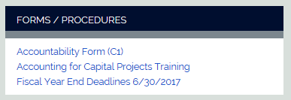
Counterfeit Bills: Now What?
Complete Accountability Form C1 found on the Controller's website.
  C1 information is used to submit a monthly CO-853 form to report loss or damage to the State Comptroller.

Slide 39
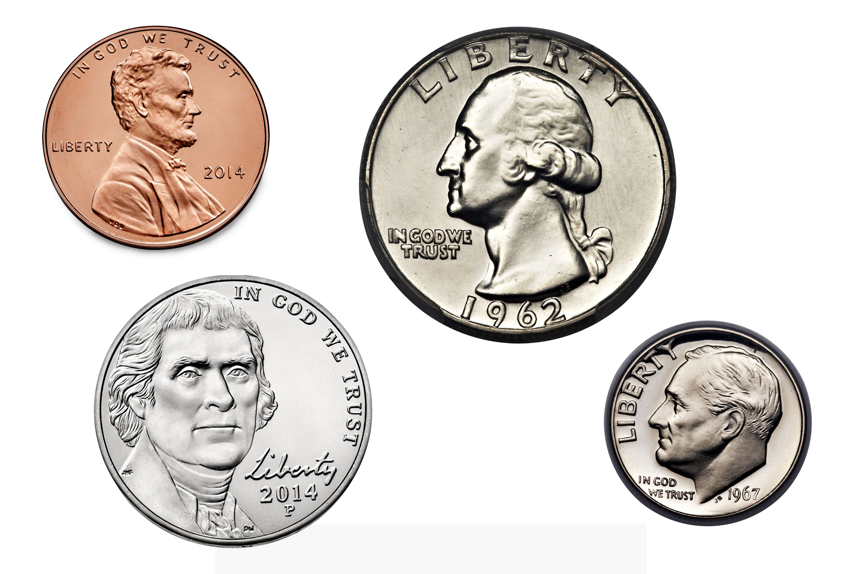
How Do You Make Change?
Change Funds are administered by Cash Operations, including increases and decreases of fund
Only purpose of a Change Fund is to provide change for cash payments received for goods or services
  Not to be used to cash checks, issue loans, customer refunds, or any other purpose
The amount on hand must remain constant and should be verified daily
  Any discrepancies in the amount must be reported and accounted for per the Over/Under Guidelines
Submit Change Fund Request Form to Cash Operations to establish fund
  New KFS account will be assigned for the change fund
Bottom line - If your department has cash on hand to use for making change, it must be accounted for in KFS

Slide 40

Over/Under Guidelines
Any overages/shortages in your cash deposit and/or change fund must be properly recorded in KFS
Full amount of true revenue collected for that day should be credited to the appropriate KFS account
Any over/under amounts in the deposit should be recorded on a separate Accounting Line, using object code 1122. Attach over/under form to eDoc.
Submit Accountability Form C1 on Controller’s website to report loss
Over/Under amounts in change fund also must be recorded in KFS using 1122 object code. A DV can then be submitted to replenish the fund. Notify Cash Operations when discrepancies are found in your change fund.
Regardless of amount, if the shortage is a result of suspected or documented theft, the shortage must be reported immediately to the Bursar, Controller, and University Police.

Slide 41
How Much Did We Learn?
Mary comes in and wants to buy a sweatshirt. It costs $25.00
Step 1: Create a record of the transaction by entering into a cash register, online system, or by filling out a pre-numbered receipt.
Receipts should be pre-numbered and include:
Date payment is received
Department
Customer name
Reason for payment
Payment type
Total amount received
Staff name accepting payment

Slide 42

So Far, So Good…
Mary is paying with a $20 and a $10.
Step 2. Using an adding machine, add the physical cash received, being sure to take note of the appearance and texture of the bills.
Mark any bill $20 and over to check for fraud.
  Calculator tapes record specific denominations received
  and can be invaluable in the event of a balancing
  difference at the end of the day.
  It is also helpful when you need to make change
  as an exact record of what transpired.
Make the change
  Put the $10 into your change fund
  Take out 2 $5’s
  Give one $5 to Mary, keep the other $5 as part of the payment received
  This will keep your deposit and change fund separate and ensure that the
  change fund amount on hand remains constant
  How else may a department handle the change fund and payments received?
Total the
money given
Less items
purchased
Change Owed
To Customer

Slide 43
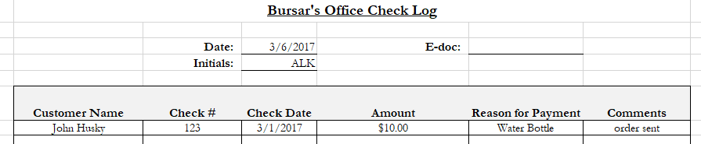
What’s Next?
Step 3. Secure payment in a cash drawer or locked box/bag until it is time to balance at the end of the day.
Mail has arrived. A customer sent a check to pay for a water bottle.
Step 1: Log the payment, ensuring legal line agrees to numeric amount written
Step 2: Secure the payment!

Slide 44
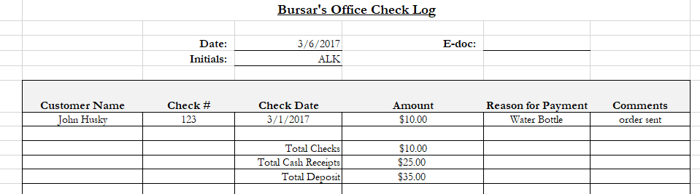
End of the Day
It’s finally the end of the day – Time to Balance!
Step 1. Add all cash and checks and compare totals to daily receipts/spreadsheet/register total.
  May be helpful to add total of all cash receipts to the check log
  Compare total backup to total physical cash and physical checks received

Slide 45
Now What?
Step 2. Submit eDoc in KFS
  Ideally, someone other than the person who received the funds should submit the eDoc. This person should also confirm total payments agree to total backup
  Submit an eDoc in KFS every day that funds are received
  This department scans checks to RDS and cash is delivered to the bank by Dunbar, so ADs should be used – one AD for checks, one AD for cash. Indicate payment type in Advance Deposit tab Description
  Make sure to attach all backup to the eDocs! Log to the checks, and Receipts to the cash

Slide 46
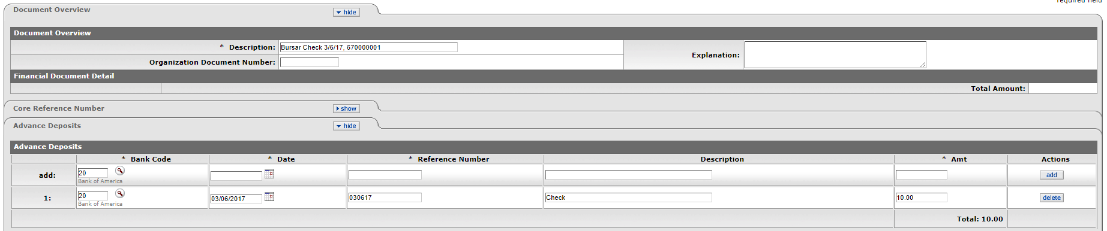
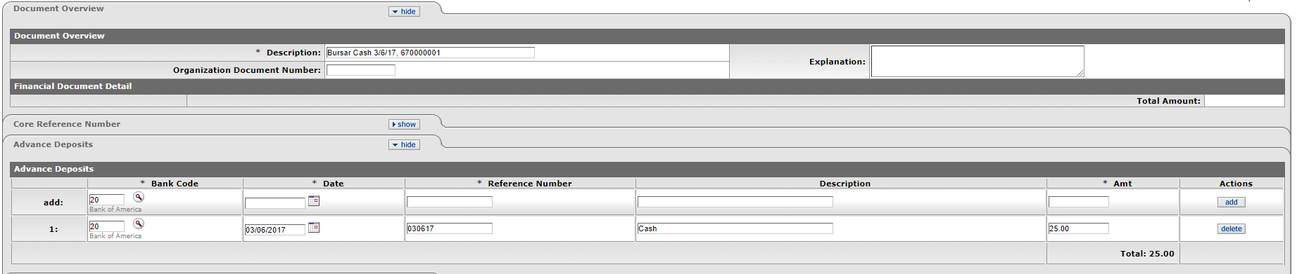
Advance Deposit - Additional details

Slide 47
Last Steps
Step 3: Secure the funds until it’s time to deposit
  Make sure you deposit your funds within State Statute requirements!
  Since the total deposit is under $500, we have 7 calendar days to deposit the funds

Slide 48
Are We Done Yet??
Almost! Remember to perform regular reconciliations at least monthly!
Should be done by someone not involved in the depositing process (i.e. not the person receiving payments, and not the person submitting the eDocs)
Multiple ways reconcile
  Example: Run Account Transaction report in KFDM for each account that cash/check/wire is deposited into for a full month. Obtain and total backup for all payments received in that month, for each KFS account. Compare and research discrepancies.
  Potential issues: Incorrect KFS account used, Deposit never delivered to CashOps, Checks never scanned via RDS, Cash never sent with Dunbar, etc.
  Contact Cash Operations if necessary to resolve discrepancies

Slide 49

QUESTIONS?
Cash Operations serves as the official central depository for collecting, receipting, and processing funds from student tuition and fees, as well as funds collected by departments within the campus community. We ensure University assets are protected, accurately and timely processed, and properly reported in accordance with state and University regulations.
We can be reached Monday – Friday from 8:30-4:30
More resources available on the Cash Operations website http://bursar.uconn.edu/cash-operations-3/
We’re here to help!

